Slide 1
First Year 2023 - 2024
Parent/Guardian/Student Information Evening
^{23rd May 2022}

Slide 2
People
Andrew Purcell – Principal
John Cleary – Deputy Principal
Anna Bourke – 1st year Year Head 2023
Andrew Little – Timetable & Options Coordinator
Iseult O’Donoghue – Mainstream SEN Coordinator
Jennifer Reilly – Home School Liaison Coordinator & Transition Coordinator from Primary to Second Level

Slide 3
What is an ETB school?
Kildare and Wicklow ETB Community College – 22 second level schools
State run school
Multi-denominational
Co-educational

Slide 4
Our School :
Mainstream School
Room 25 – ASD Units (12 students)
Room 26 – MLU Unit (8 students)
1st year – 142 students in total
580 students in school
Junior Cycle; JCSP programme; L1LP & L2Lp
Transition Year
Leaving Certificate traditional
Leaving Certificate Applied & LCVP

Slide 5
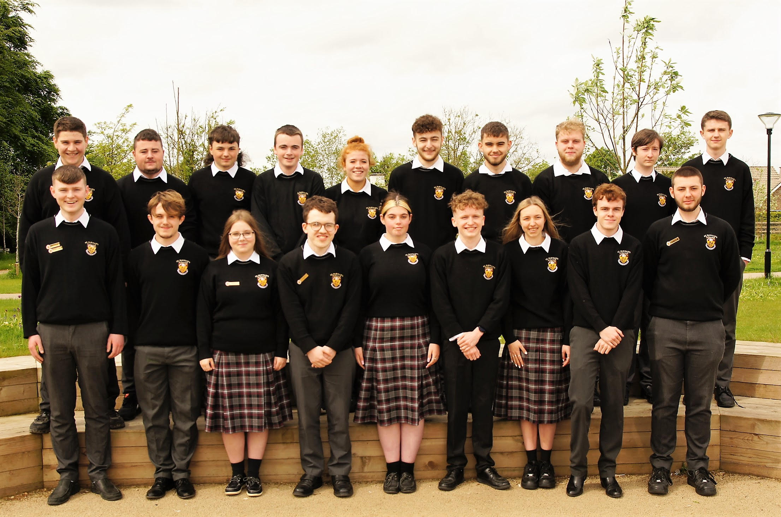
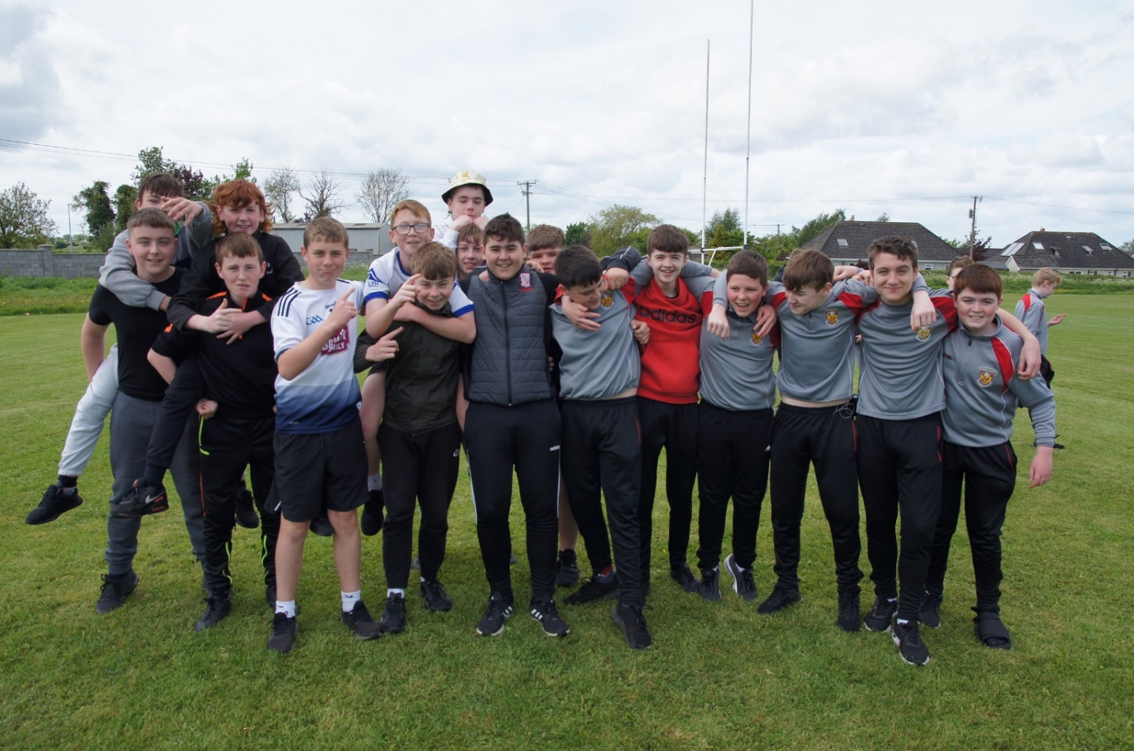
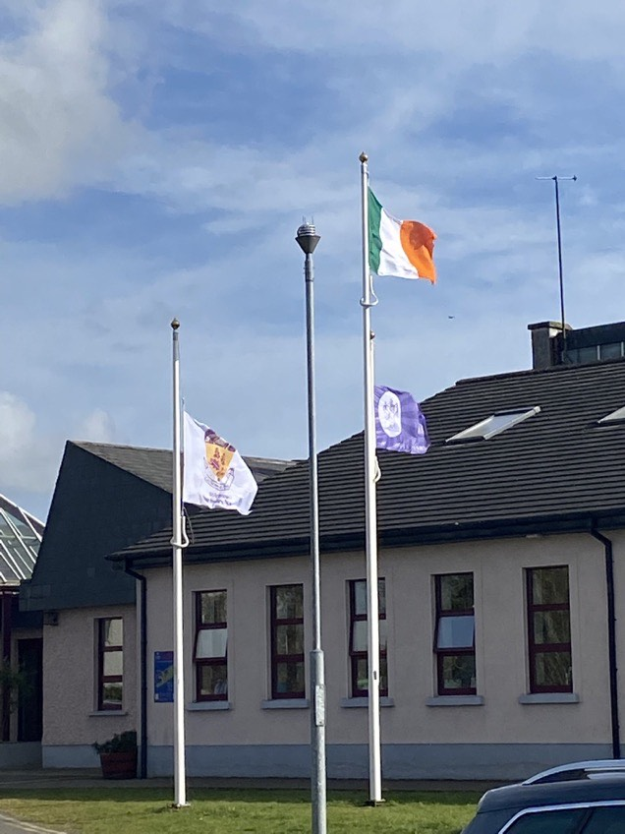

Slide 6
What is in your Folder?
A letter from the Principal, Deputy & Year Head
Map of School
Parents Junior Cycle Information Sheet
Student Support Team Information
Uniform outline
Timetable Structure, sample and equipment list
Areas of Concern
Parents’ Association letter

Slide 7
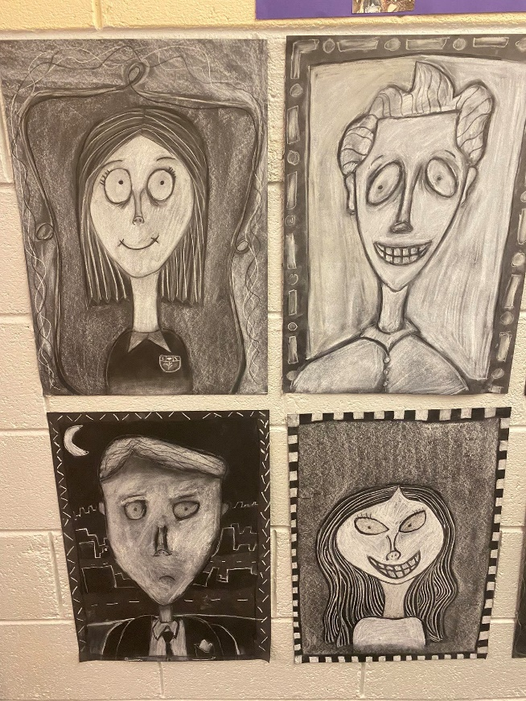
Purpose of evening
To meet some of the people who will be supporting your son/daughter
Outline important issues in order to help your son/daughter get full benefit from their time here in St. Farnan’s PPS
FIRST 3 DAYS for 1st year 2023/24:
Friday 25th August, Monday 28th August, Thursday 31st August 2023

Slide 8
Mission Statement St Farnan’s PPS
St. Farnan’s is a school community which strives to be inclusive and caring.
We aim to develop all students to reach their full potential, personally, academically and spiritually, so that they may enrich the school and wider community.

Slide 9
Support people and structures
Year Head & Tutor Team
Guidance Counsellor – Ms Anita Cleary
Counsellor - Ms Annette Duggan
Care Team
Resource Department including ASD & MLU rooms
Prefect Team (6th year) & 5th year mentors to 1st years
Parents’ Association Representatives
Student Council (Reps from each year group)
Board of Management – Cllr. Brendan Weld (Chair)
Kildare & Wicklow ETB (Education & Training Board)

Slide 10
Guidance Service
We offer personal counselling, support with homework/ study skills
Help students to settle into primary school
Confidentiality: Contract with the student
What is said to the Guidance Counsellor is confidential. However, if we feel that the young person or someone else is at risk, we inform the principal
Referral: Tutor/ Year Head; Self- referral
Parent can contact Guidance Counsellor directly

Slide 11
Social Media
Mobile phones MUST be switched OFF while in the school grounds unless being used for an educational activity with a teacher’s permission.
Students must NOT photograph, video, manufacture or edit any images or content from school, which brings the school into disrepute.
Students in breach of this are breaking the law under General Data Protection Regulation 2018.
Students who SHARE any material without the express permission of the school authority is liable to sanction within the school’s Code of Behaviour.

Slide 12
Anti-Bullying (including cyber-bullying)
School Anti-bullying policy available on school website – recently updated 2023.
Aim is to reform student involved in this type of behaviour and prevent it from re-occurring.
Every student should feel free from bullying and intimidation.
Preventative Strategies
SPHE classes
Anti-bullying focus week
Building positive relationships programme

Slide 13
Prosperous Community College

Slide 14
Prosperous Community College

Slide 15
Finance
Way2Pay online payment system in use in school
Student contribution for 1st year is €225 (or €200 with medical card – can be paid in instalments) - Rent of locker, 24/365 pupil insurance by IPB; school journal; administration fee is included in this figure.
All students benefit from DES school book grant which covers the majority of the price of all books;

Slide 16
TIMETABLE OPTIONS
Mr. Andrew Little

Slide 17
Timetabling & Options
The option subjects for 23-24 will not be made available until mid-late June.
Currently, we have options on hold due to recruitment.
Any issues or queries in relation to options can be directed to alittle@stfarnans.ie

Slide 18
Junior Cycle Curriculum:
Core: English, Irish (unless holding an official exemption) & Maths
All students then study: History, Geography, Science.
Wellbeing: over the three years of Junior Cycle there will be delivery of 400 hours of Wellbeing. Wellbeing is made up of PE, SPHE and CSPE.
For First Year we also offer Wellbeing Modules: Students study each module for 6-7 weeks. These include; Yoga, Music, Art Appreciation, Ethos and Learning to Learn.
First Year students for 23-24 will also get one period per week of Literacy skills and one period per week of Digital Numerical Skills.
Finally, students meet with their tutor for 8 minutes everyday for Tutor/ Pastoral care time.

Slide 19
Timetabling of Support Classes:
Students with additional needs will receive support in many ways.
Co-teaching
Withdrawal classes
Irish Exemptions
More information can be provided on this by Ms. O’ Donoghue

Slide 20
Wellbeing
400 hours over 3 years
Tutorial/Pastoral Care Physical Education
Social, Personal and Health Education (including Relationship and Sexuality Education)
Civic, Social and Political Education
Guidance & Ethos training
Other courses such as Digital Literacy & Sports Days, Trips

Slide 21
Ms. Iseult O’Donoghue S.E.N. Coordinator Mainstream

Slide 22
Support for Additional and Special Education Needs in St Farnan’s PPS.
Inclusion Policy available on school website
Inclusion on the Continuum of Support:
All students can avail of support when they need it: no diagnosis is required

Slide 23
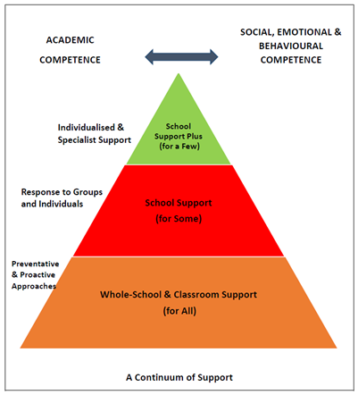
Support Provision in St Farnan’s PPS
Co-teaching in mainstream classes
Small groups withdrawn for learning support
Individual, one-to-one support
SNA Support
Differentiated programmes such as Level 2 Learning Programmes
Special Classes - Moderate and Autism Classes
Reasonable Accommodations for state exams (RACE-where applicable)

Slide 24
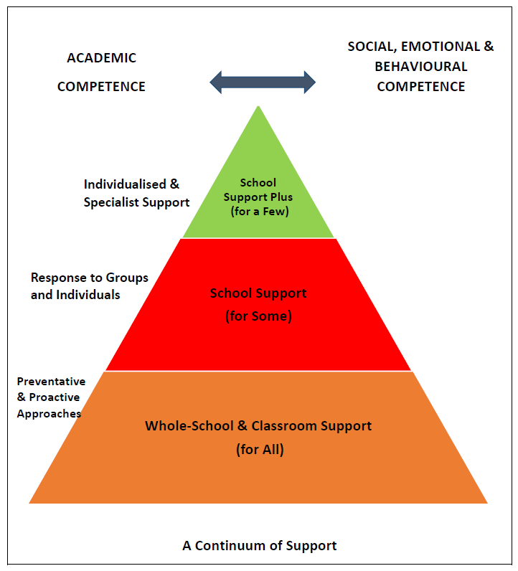
Support Provision in St Farnan’s PPS
Junior Cert Schools Programme (JCSP)
Level 2 Learning Programmes (L2LPs)
Mentoring and ‘Check and Connect’ support
Support with using assistive technology
Study, organisation and learning skills
Student Support File and Individual Planning
Irish and Language exemptions

Slide 25
Support for Additional and Special Education Needs in St Farnan’s PPS.
Information about students’ needs collected from:
Application form
Professional Assessment reports
Parents/ guardians consultations & communication
Primary school reports & Primary Passport
School– based formal and informal assessment
School-based observations and subject teacher feedback
Entrance Assessment and further standardised testing
All documentation held in the strictest confidence and following GDPR guidelines

Slide 26
Support for Additional and Special Education Needs in St Farnan’s PPS.
Standardised Assessments:
Standardised assessments that will help us to teach your child.
Cognitive Abilities Test – measure of strengths and needs of student
Aptitude or Skills tests – measure of literacy and numeracy skills
Standardised by age

Slide 27
Information from Parents
Please make sure that you send in all information about your child’s learning needs to St Farnan’s PPS so we can support their transition from Primary school and their learning throughout their time in Post-Primary.
SET department work in partnership with parents/ guardians and students: we are all on the same team!
It is essential that we receive all information about your child’s learning – needs and strengths ahead of the start of their first term in St Farnan’s.

Slide 28
Support for Additional and Special Education Needs in St Farnan’s PPS.
Irish exemptions in First Year
St Farnan’s cannot support your child to be exempt from Irish if we do not have a copy of their Irish exemption.
Please ensure all documentation is provided to the school.
Contact the school office or email for the attention of SET Department / Iseult O’Donoghue – we are looking forward to working with you all!

Slide 29
Ms. Anna Bourke Year Head

Slide 30
Challenges for 1st Years
Longer day
Being the smallest
New teachers and teaching methods
New subjects / New timetable
New friends
Lockers
Changing classes for each subject
Management of homework - some homework may not be due for a few days
New language of post-primary school

Slide 31
What Can Parents Do
Talk to your son/daughter about 1st Year
Acknowledge that 1st Year can be difficult
Have clear boundaries and limits in place
Encourage your son /daughter to get involved in school life
Encourage a healthy lifestyle (sleep, diet, exercise)
Address problems immediately (regarding homework, friends, behaviour) and communicate with the school ASAP if there is a problem
Homework timetable- try to get homework completed within a certain time - Help students to get organised
Parents are encouraged to disclose to SEN Department in school if your child has learning difficulties & encourage supports in school

Slide 32
St. Farnan’s Positive Behaviour Code

Slide 33
Uniform
Black shoes (leather or leatherette)
School coat only. New heavy coat available also
Piercings (One stud in each earlobe) – this is the only jewellery permitted.
Hair (Natural colour only. No pinks, purples etc. and no patterns/designs in hair)
PE – 1 double class per week
Runners, any colour
School tracksuit & tee-shirt
NAMES ON EVERYTHING PLEASE!

Slide 34
Use of journal
Main means of communication between school and home
Policies and permits – please sign
Punctuality - late stamps
N.B. Sign nightly and check regularly.

Slide 35
Getting the basics right!
Resilience
Be organised - Books/ equipment etc.
Do homework
Get involved! (Extra-curricular activities)
Be polite in dealings with others

Slide 36
Extra Curricular
Football
Hurling
Soccer
Basketball
Horse Riding
Games Club – chess, draughts, 30 secs etc
Open Mic
Well-being/Art/Music
School Band & School Choir
Drama/Musical

Slide 37
Ms. Jennifer Reilly Home School Community Liasion Transition to second level school Coordinator

Slide 38
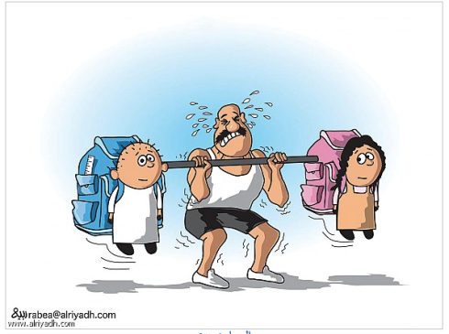
Making the transition from primary to secondary school
Possible causes of stress:
Several teachers a day
Bigger school
Movement from room to room
Following a rigid timetable
Lockers
Heavier bag/ P.E. gear etc.
Longer day
Making new friends

Slide 39
Pastoral care structure
Subject teacher ->Class Tutor
->Year head/Guidance Team
->Deputy principal
->Principal
This structure is designed to ensure student receives all supports available, has someone to talk to if there is an issue and prevent him/her rising up the referral chain without a number of interventions occurring.
Aim is towards positive discipline approach.

Slide 40
Attendance and punctuality - HSCL
Regular attendance and punctuality avoids work being missed which may lead to stress
Message/email/phone call to school on morning of absence followed by note ( in allocated part of journal) on return to school
Dental and G.P. appointments, if possible, after school/Friday afternoons
Catch up on missed work
If student is ill they should of course stay at home
If a student feels ill during school day – report to YH or DP who will phone a parent/guardian
Two lates in a week merits a detention. TESS (Tusla) letter sent out to parents to report on number of absences – highlight a large number of absences within a time period even if you have sent us a note about it (e.g. 5 days or more in a month)
If there is any discrepancy in the number of days reported and your own records, please let us know (VSware).

Slide 41
Mr. John Cleary Deputy Principal

Slide 42
Student Voice
Student Council
Prefects
Mentors
Open Evenings
Board of Management

Slide 43
Principal’s Notes
Communication
Journal, phone, appointments
Ensure current phone numbers on our system, nominate a person in case of emergency, text message system

Slide 44
Principal’s Notes 2
Assessments
ongoing class tests (please ask your children about homework and tests and sign test)
More formal assessment tests:
Christmas Assessments (first formal report in January)
Summer Assessments (formal report in June)
Parent Teacher meeting
One per year

Slide 45
Finances
Voluntary contribution which includes:
24 hour, full year pupil insurance
School Journal
Book rental Scheme
Administration charge
Locker Rental
Online payment – Way2Pay (€225 or €200 if medical card holder)
Some additional costs for various trips and events

Slide 46
Vsware for Parents/Guardians
Opening student management system for parents to enter 1st year Student option choices
Distribute web address, user name and password.
https://stfarnans.app.vsware.ie/
Access to personal data, timetable, results, attendance, merits and conduct comments.
St Farnan’s uses a text messaging system for important information. If you update your mobile number please let us know.

