Slide 1
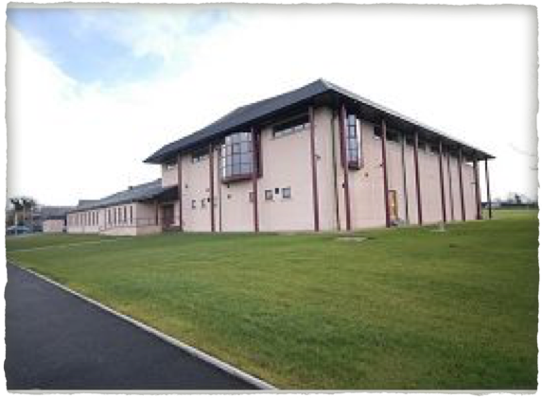
St.Farnan's Post Primary
Options after the Leaving Certificate
Class of 2020/2021

Slide 2
Choosing The Right Course
Step 1: Consider your INTERESTS, SKILLS, VALUES, PERSONALITY

Slide 3
Interests
Course content should be the main consideration when deciding upon your choices for next year.

Slide 4
Skills
A course should match a person's skills set.

Slide 5
Values
Courses that match your value set as a person are more likely to be fulfilling.

Slide 6
Personality
Does the course suit your personality?

Slide 7
Step 2: Research courses and the Colleges/Universities

Slide 8
Step 3: Match what you have come to know about yourself (self - assessment) to a course/s

Slide 9
Step 4 - Take Action
Once fully informed about relevant courses, it is then time to start the application process.

Slide 10
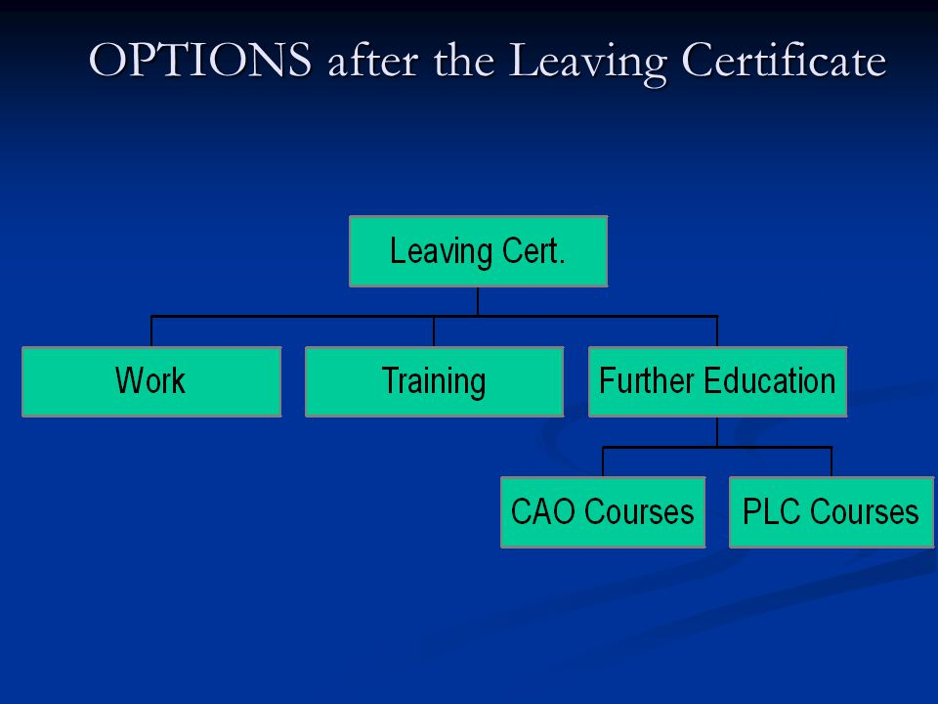

Slide 11


Slide 12
Central Applications Office (CAO)
The CAO is the organisation that deals with applications from students who want to study in an Institute of Technology or University

Slide 13
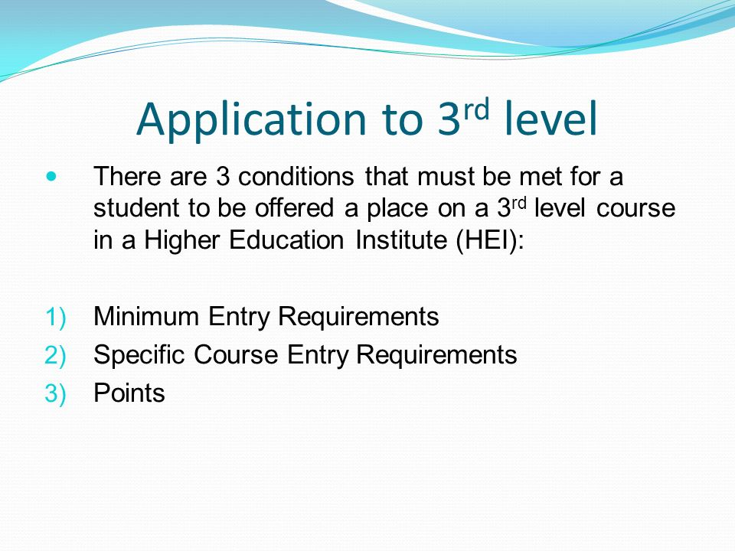

Slide 14
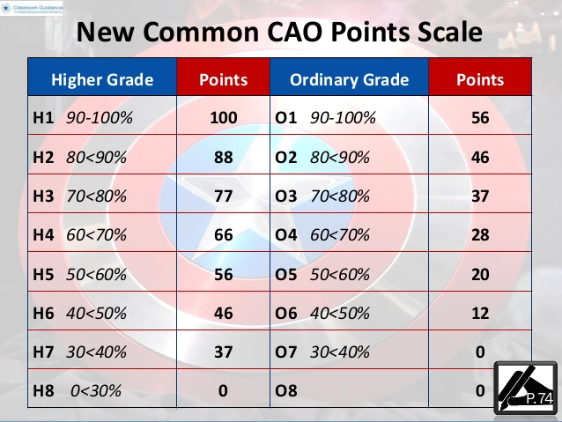

Slide 15

Matriculation(Minimum) Entry Requirements
To be allowed into a college for any course, you must meet the college 'matriculation requirements'

Slide 16
The National University of Ireland
(Maynooth, UCC, UCD and NUI Galway)
Requires six subjects: English, Irish and four others from the Leaving Cert.
Two of these subjects must be at least Grade H5 at Higher Level and at least Grade H7 or O6 in four other subjects.
A third language is required also for a lot of the courses in NUI colleges

Slide 17
Trinity, UL and DCU
Requires six subjects, two(three for TCD and DCU's BEd) of which must be at least Grade H5 at Higher Level
Subjects must include a 06/H7 in English, Maths( foundation level maths acceptable for some courses) and a language other than English(e.g. Irish).

Slide 18
Institutes of Technology and Technological Universities
For Level 8 Honours degrees, 6 Leaving Certificate subjects, with at least Grade H5 in 2 subjects at Higher Level and Grade 06/H7 in 4 other subjects, including Maths and either Irish or English

Slide 19
Institutes of Technology and Technological Universities
For Levels 6 and 7(Higher Certificate and Ordinary Degree): 5 Leaving Cert subjects at Grade O6/H7, including Maths and either Irish or English

Slide 20
Specific grades in subjects
Some courses require that you have a certain grade in a subject to gain entry into the course e.g. To study primary teaching in Maynooth University you need to obtain a H4 in Irish as part of the requirements to get onto the course along with meeting the minimum entry requirements as well as points.

Slide 21
Exemptions
If your son or daughter has an exemption they are obliged to contact the colleges that require Irish or a third language for entry.
The 4 NUI colleges ( UCC, UCD, NUI Galway and Maynooth University) form is available on the NUI website.
If a student does not inform the college of their exemption, they will not receive an offer from CAO should Irish/ Third Language be a requirement.
Students wishing to study in Trinity need to fill out a form which is available on their website if a student is exempt from Irish and a Third Language.

Slide 22
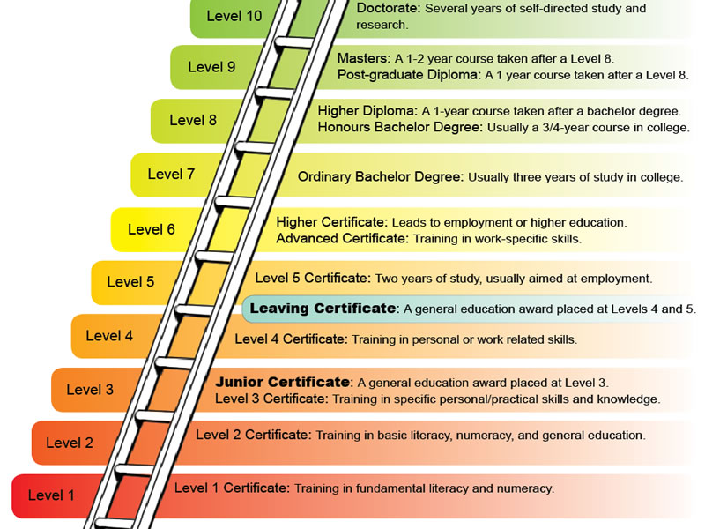

Slide 23
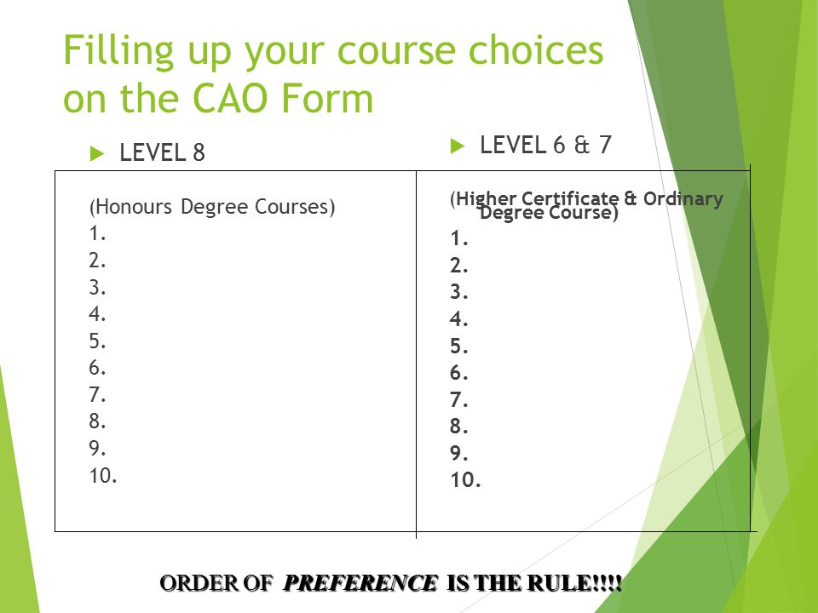

Slide 24
Don’t be the one in Six!
What is the number 1 cause of drop outs in Third Level courses?
“The most popular reason for students to drop out, based on the Why Students Leave report published by the National Forum for Enhancement of Teaching and Learning in 2015, is that the student chose a course that did not suit themselves”.
“Students also have a role to play by researching their course of study thoroughly before applying to ensure that it is really what they want to do and that they feel they will be able to get through the difficult parts of the course”
Peter O’ Donovan - Trinity News, Jan 2017

Slide 25
Important things to remember
Know what the course involves before applying. If you are not interested in the modules that are covered in the course, then the course might not be for you.
Courses should be placed in genuine order of preference on the form.
Only apply for courses you genuinely want to study.
Course titles don’t always reveal the true focus of the course.

Slide 26
Order of events within the CAO system
Apply to the CAO on the CAO website by the 1st February 2021. Cost is 45 Euros. Online application prior to January 20th is 30 Euros.

Slide 27
Order of events within the CAO
In early May applicants may change their courses. An applicant may change the order of courses selected or introduce new courses.
One can change their mind up until July 1st. Restricted courses must be applied for by February.

Slide 28
Order of events within the CAO
Mid August Leaving Cert results are issued. The CAO offers applicants places a few days after the results.
The applicant has seven days to accept or reject the offer. If you wish to accept the offer you must reply to the CAO within the specified time.

Slide 29
How are offers made?
Offers are made on the basis of the L.C.results achieved by each student, the number of students applying for a particular course and the number of places available on that course.

Slide 30
Deferring a place
If you wish to defer an offer of a place, you do not accept your offer. You must email or write to the Admissions Office of the college immediately.
The letter or email must arrive in the Admissions Office of the college at least two days before the reply date shown on the Offer Notice.
The college will then communicate their decision to you directly.

Slide 31
PLC Colleges - There are many reasons why students choose to complete a PLC course
Some students may not have gained sufficient CAO points to obtain the course they wanted to study. A PLC course can offer a student the possibility of transferring to a IT/University course with their PLC points.

Slide 32
PLC Courses
Taster year- Some students may be reluctant to commit to a full three or four years if they are uncertain about this being the right choice for them. A PLC in that area of study can provide a useful taster of what the area of study would be like and students can then make a more informed choice whether to proceed with this area of study.

Slide 33
PLC Courses
Each PLC course incorporates a work experience module which gives students direct experience of the type of work related to their course of study.
A chance to acquire a qualification leading to employment.

Slide 34

Apprenticeships
Students can complete craft apprenticeships, for example, electrical and plumbing apprenticeships.
Craft apprenticeships are generally made up of 7 phases over the duration of four years.
Three phases are 'off -the job' and four are 'on - the - job'.

Slide 35
Apprenticeships - 58 available apprenticeships at the moment
There are also new apprenticeships since 2016.
These new style apprenticeships can lead to an award ranging between Level 5 and Level 10 on the NFQ.
Learning alternates between a workplace and an education /training institute with a minimum of 50% on the job training.

Slide 36

HEAR Scheme
The Higher Education Access Route Scheme is a college scheme that offers places on reduced points and extra college support to school leavers who come from families who fall within a certain income threshold.

Slide 37
HEAR Scheme
HEAR applicants must also meet a range of social and cultural indicators to be considered for a reduced points place and extra college support.
Some colleges are linked to the scheme for example, Maynooth University.

Slide 38

DARE Scheme
DARE is a third level admissions scheme for students with an ongoing illness, physical difficulty or SLD etc.

Slide 39
DARE Scheme
Successful DARE applicants may be offered a place on reduced points from participating Third Level institutions.

Slide 40

SUSI (Student Universal Support Ireland)
SUSI is Ireland's single national awarding authority for all higher and further education grants.
SUSI offers funding to eligible students attending PLC/ Higher Education courses.

Slide 41
SUSI
Students apply for a grant on the SUSI website
To be eligible for a grant you must meet certain criteria

Slide 42

Useful Websites
Qualifax
Careers Portal
SUSI
Access College
apprenticeship.ie
www.ThisisFET.ie
www.fetchcourses.ie

Slide 43


Slide 44




Slide 45
How a parent/s can help
Discuss with your son/daughter his/her plans.
Read through the literature he/she has gathered.
Help him/her to prioritise his/her career/course choices.
Help your son/daughter fill in the various forms.

Slide 46


Slide 47

Contact
Ms Cleary is available for guidance appointments with students throughout the year
Email address is anitacleary@stfarnans.ie

